Slide 1

Partition of Bengal, 1947
The key event in partition of india on the basis of religious community

Slide 2

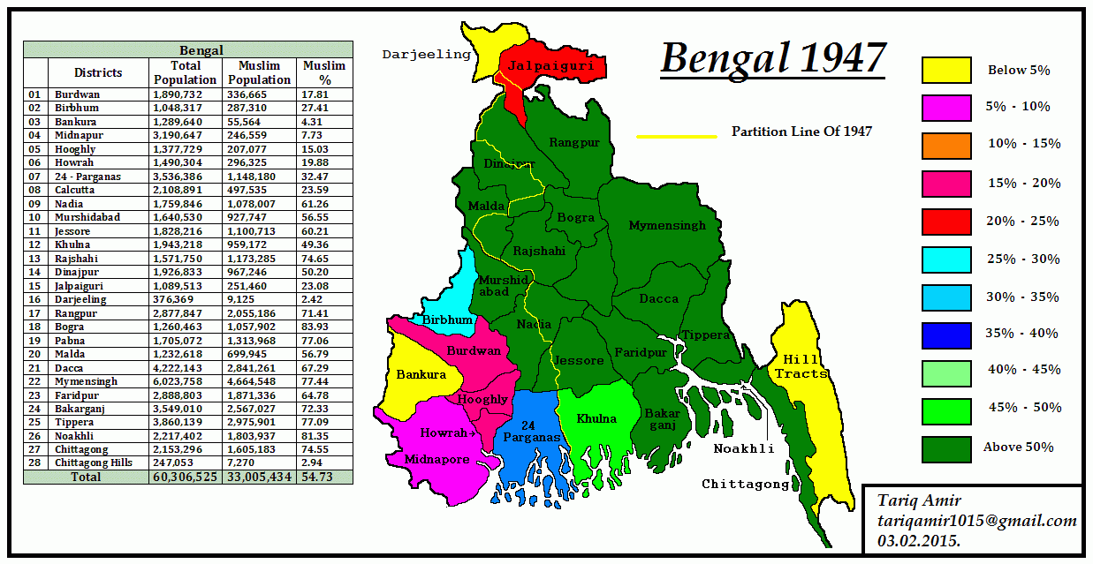
Bengal in 1947

Slide 3

History
How the Bengal Province of Indian Sub-Continent partitioned under British Rule
1947 Partition of Bengal
1905
Bengal Partition
1911
Annulment of Bengal Partition

Slide 4

Leading FINDINGS
Bengal Partition, both at 1905 and 1947, was fueled by religious difference among Bengalis.
The Bengal Hindu Leaders, opposed the Bengal Partition in 1905 and brought about its annulment in 1911,demanded the partition of Bengal in 1947.
The Muslims welcomed the partition of Bengal in 1905, and they ended up opposing the partition of Bengal in 1947.

Slide 5
Origin of Bengal nationalism and evolution
The basis was laid down during the rule of independent Sultans of Bengal.
The Hindu-Muslim conflict during British rule gave rise to Indian nationalism and Indian Muslim nationalism.
Bengali Hindus opted for distinct Bengal recognition besides nurturing Indian nationalism.

Slide 6
Indian Muslim Nationalism
Bengali nationalism faced crisis after the partition of Bengal in 1905 and the following events.
The rise of Indian Muslim nationalism in Bengal.
A defense for Bengal nationalism.
The idea of maintaining the independent status and the national distinctiveness of the Bengalis within the framework of Greater India.

Slide 7
Bengal pact,1923
Swaraj Party formed by C.R. Das to preserve the interest of Bengal nation.
C.R. Das, Fazlul Haq and H.S. Suhrawardy entered into an agreement to settle Hindu Muslim problem in Bengal.
To preserve the Bengal nationalist identity in all India context.

Slide 8
Provincial Autonomy in bengal
Provincial autonomy in Bengal introduced in 1937
The political supremacy of the Muslim majority was established in Bengal.
Abolition of Zamindari system by Fazlul Haq ministry.
Influenced the Hindu leaders to confide in Indian nationalism instead of Bengal identity.

Slide 9
Demand of partition- Bengal and india
Bengal leaders leaned to Muslim nationalism to defend Bengal nationalism.
In 1940, they demanded the Partition of India, to let Bengal form an independent sovereign state
Hindu leaders demanded the partition of Bengal in 1947, to counteract the Division of India.

Slide 10
Congress strategy
The Cabinet Mission argued with Jinnah on 16 April, 1946, that consistent demand for Pakistan would not allow its claim to Non-Muslim territories in consequence.
The communal riot in Punjab( March, 1947), accelerated the demand for the partition of the Punjab.
Political strategy to counteract League’s demand of Pakistan, with the partition of Bengal and Punjab, with the stronger center remaining under control of congress.

Slide 11
Congress as Hindu Organization
Congress put forward in press conferences and interviews to support partition of Punjab into two provinces and the same fate for Bengal on the rise of communal riots.
This exposed the Congress as the Hindu organization, looking forward to saving the interest of the Hindu population of India.
This in turn proved their subtle support for division of India on communal basis, the League’s demand.

Slide 12
Mountbatten’s strategy
The resolution put forward by Congress was used by Mountbatten to convince them to accept the demand of partition of India.
He infused the Hindu nationalism and favoritism in Congress leaders minds.
Congress High Command ( Neheru, Gandhi and Patel) accepted the proposal, with a view to weaken Pakistan demand and they asked for partition of Bengal and Punjab.
Jinnah initially declined the proposal, but later on he couldn’t compromise with the undivided India proposal and accepted the partition proposal.

Slide 13
Response of Bengali Hindus
Lead by Dr. Shyamaprasad Mukherjee and his Hindu Mahasabhite followers of Bengal.
Congress leaders of West Bengal supported for partition.
Congress leaders of East Bengal apprehended the decision non-executable on the long run.
Hindu Mahashava was all supportive for Bengal partition for Hindu majority territory into a separate province.
Sarat Chandra Bose, opposed to the move of Partition of Bengal.

Slide 14
Movement for independent bengal
Muslim leaders of Bengal opposed the partition of Bengal on communal basis.
Autonomous Bengal within the framework of Pakistan.
Alternative scheme- a sovereign and independent Bengal state.
H.S. Suhrawardy,Abul Hashim and Sarat Chandra Bose were the torch bearers in the scheme, to avoid joining either Pakistan or Hindustan, retain the Greater Bengal.

Slide 15
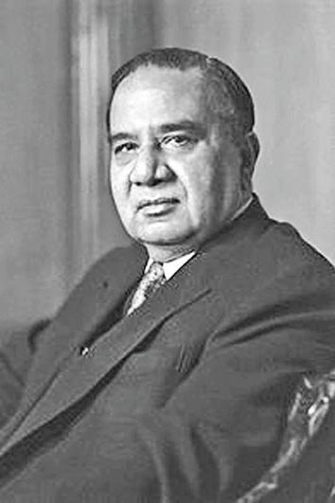
Huseyn Shaheed SUHRAWARDY
The pivotal leader who foresighted united Bengal.

Slide 16
Role of H.s. Suhrawardy
On 17 March, 1947, H.S. Suhrawardy said in a meeting that Pakistan was inevitable to come and Bengal would be a undivided part of it.
On the verge of inevitable partition of Bengal by the demand of Hindu leaders, he adopted the scheme of a sovereign, independent Bengal.
He pleaded the possibility of a prosperous Greater united Bengal and deprecated the demand of Hindu Mahashava for partition of Bengal.
Met with Congress leader Gandhi and League leader Jinnah with the plead of united Bengal.

Slide 17
Tentative Agreement – Greater Bengal scheme
Mr C.R. Das’s formula
Deprecation of Lahore Resolution
Muslim league will hold the Government of Bengal Office.
Bengal shall not join Pakistan or Hindustan.
Seats for the Muslims, Hindus and the scheduled castes and other minorities shall be fixed according to their population ratios.
Central Bengal, Eastern zone and Western Zone

Slide 18
Congress opposition
Congress High Command opposed the move of United Bengal – Sarat bose’s approach was declined
He denounced the 3rd June plan – Partition of India, along with partition of Bengal and Punjab.
The members of the Bengal legislative assembly got no option to express their minds other than the choice is limited to Hindustan and Pakistan.

Slide 19
League’s Opposition
Maulana Akram Khan disapproved the idea of united Bengal.
No plan except in consonance with Lahore Resolution would be accepted.
Bengal provincial Muslim league working committee didn’t support the greater Bengal scheme.
Rejected by both provincial committee and League’s high command.

Slide 20
Final days
Congress high command accepted 3rd June Plan.
Jinnah gave assurance of acceptance of this plan by Muslim League.
Suhrawardy accepted the verdict of the Muslim League council.

Slide 21
The agony is over. Independent sovereign Bengal has been stabbed in the back and Bengal will soon be partitioned. –.
H.S. Suhrawardy

